Slide 1
Find the weakness in your ML model
Pauwel De Wilde
BeCode
Bouman 3.31

Slide 2
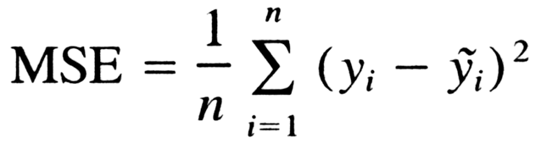
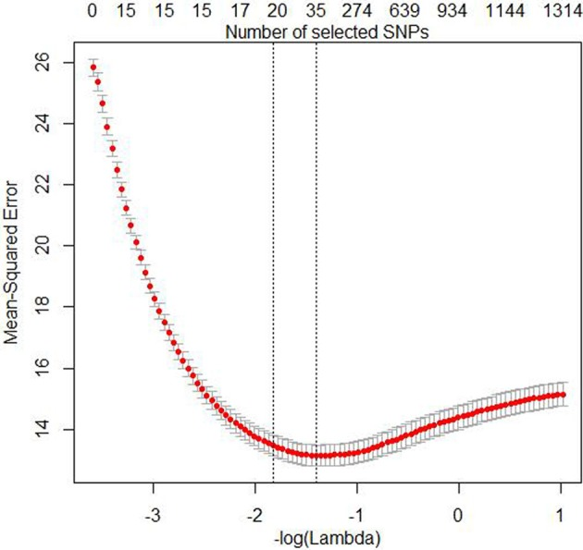
MSE
Mean Squared Error
Linear regression
Averaged error

Slide 3
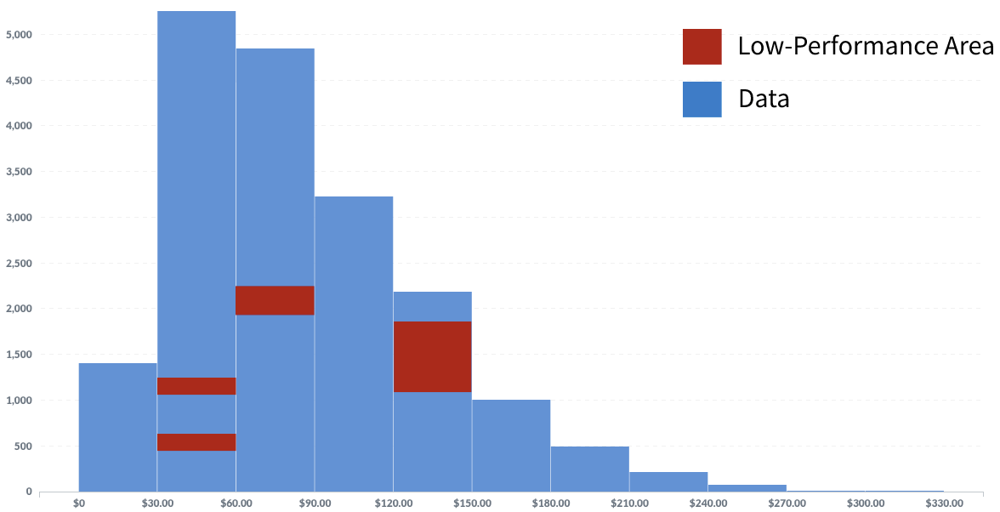
IBM’s FreaAI
Not free
Makes it clear where to interfere
Reproducible

Slide 4
How?
Data optimization
(Standardizing, resampling, etc.)
Highest Density Regions
Data input
Slicing
Decision Trees

Slide 5
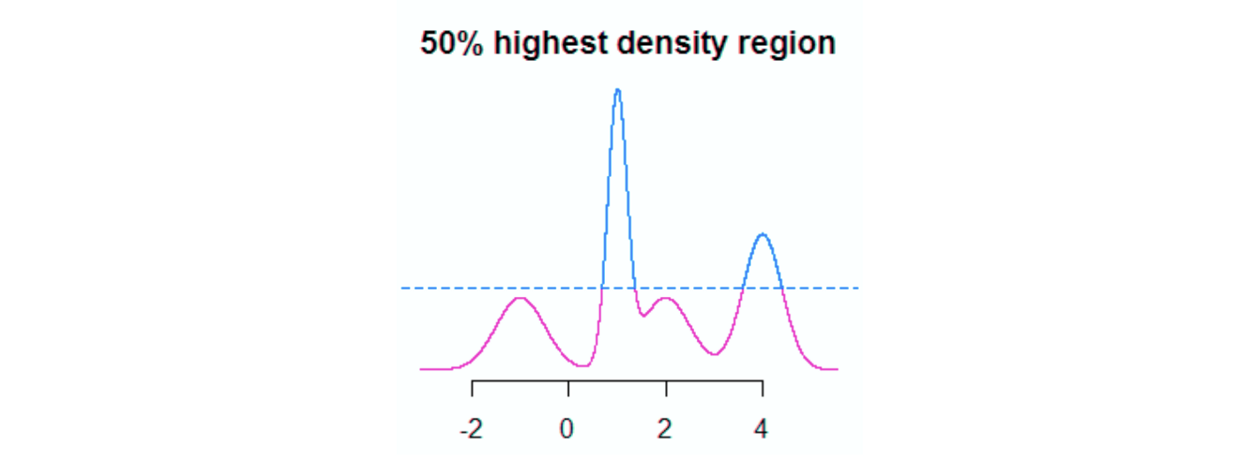
HDR
Highest Density Regions
Find smallest area with certain proportion of data
E.g.: 50% of data above blue dotted line

Slide 6
HDR
Highest Density Regions
Iteratively decrease range by value of ε
Increase in accuracy = low accuracy between this point and previous iteration

Slide 7
HDR
Highest Density Regions
Numeric data only

Slide 8
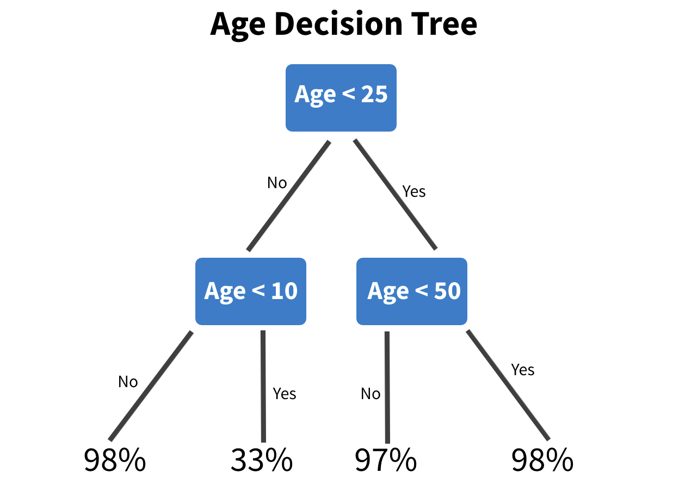
Decision Tree
Non-numeric (categorical) data
Combinations of two features

Slide 9
Decision Tree
Look for splits with lowest accuracy
Very fast way to spot weakness
Repeated for all feature combos

Slide 10

Keep in mind
Statistical significance:
Only keep the worst results

Slide 11
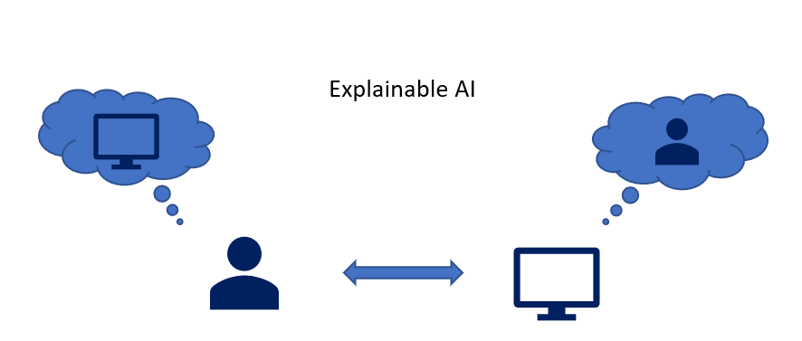
Keep in mind
Statistical significance
Only keep the worst results
Explainability
Low number of features
High chance for solution

Slide 12
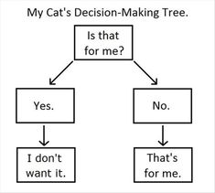
Keep in mind
Statistical significance
Only keep the worst results
Explainability
Low number of features
High chance for solution
Minimal support
At least 2 misclassifications
Cover 5% of testing error

Slide 13

Thank you for your attention!
Questions? Go ahead!

Slide 14
Source:
https://michaelberk.medium.com/how-to-find-weaknesses-in-your-machine-learning-models-ae8bd18880a3

